Slide 1

Contents
Analysis of FMCW radar parameters related to mD effect produced by drones
Extraction of constraint on parameters due to physical limitations of radar and due to the need to observe micro doppler effect
Possible relation between Chen backscattered signal model and Kulpa model

Slide 2

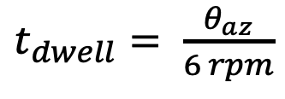
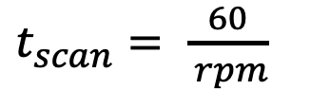
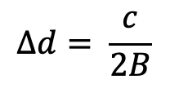
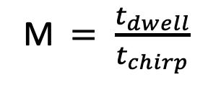



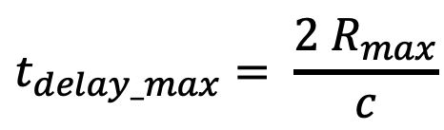
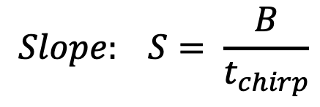
FMCW radar parameters
Time parameters:
$$t_{delay_max}= \frac{2 R_{max}}{c}$$
M$= \frac{t_{dwell}}{t_{chirp}}$
$t_{dwell}= \frac{θ_{az}}{6 rpm}$
$$t_{chirp}=k∗ t_{delay_max}$$
$t_{scan}= \frac{60}{ rpm}$
Unambiguos range measurement
Relation with bandwidth:
$$Δd= \frac{c}{2B}$$
$$Slope: S= \frac{B}{t_{chirp}}$$
$$f_{b_max}=S ∗ t_{delay_max}$$
$$B=f_{max}− f_{min}$$
$$f_{ADC}=2 f_{b_max}$$

Slide 3
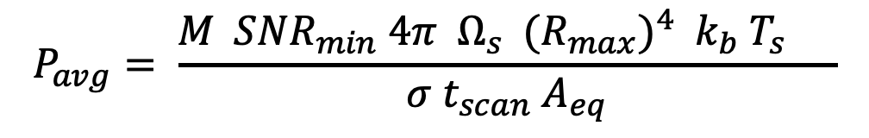
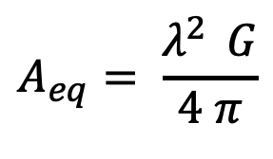
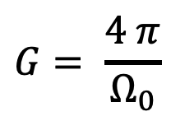

FMCW radar parameters
Relation with power:
$$P_{avg}= \frac{{M SNR}_{min} {4π{ Ω}_{s} {{(R}_{max})}^{4} { k}_{b} T_{s} }_{} }{σ t_{scan}{ A}_{eq}}$$
Where:
$$A_{eq}= \frac{λ^{2 } G}{4 π}$$
$$G= \frac{4 π}{Ω_{0}}$$
$$Ω_{0}= θ_{az}{ θ}_{el}$$
How the necessary average power change by changing other parameters

Slide 4

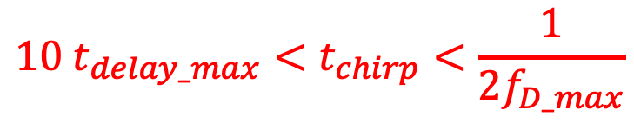

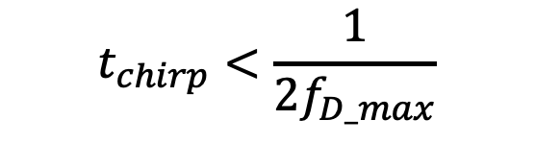

Extraction of constraint
Parameters observed so far are limited by physical constraint of radar (1) and also by
the necessity to observe mD effect produced by a drone (2).
(1) Physical constraint on chirp duration:
Lower bound
Upper bound
It comes from unambiguous doppler
measurement
$$t_{chirp}<\frac{1}{2f_{D_max}}$$
$$t_{chirp}>10 t_{delay_max}$$
$$∧$$
$\frac{1}{t_{chirp}} >$ 2 $f_{D_max}$
$${10 t_{delay_max}<t}_{chirp}<\frac{1}{2f_{D_max}}$$
(1)

Slide 5

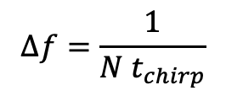

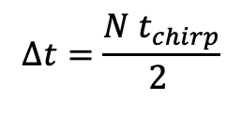


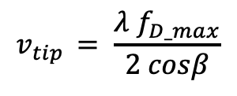

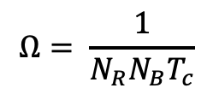




Extraction of constraint
(2) Constraint on chirp duration due to the need to observe mD effect
Helicopter drone case
$$Ω= \frac{1}{N_{R}N_{B}T_{c}}$$
$$v_{tip }= \frac{λ{ f}_{D_max}}{2 cosβ}$$
${ f}_{D_max}$ = 5510 Hz
$T_{c}$= 20 ms
Blade Flash period
$v_{tip}$= 95 m/s
$β$ = 15°
Defined the number of blade flash that is necessary to observe as ${ n}_{b}$
First constraint on dwell time:
$$t_{dwell_min}={ n}_{b}T_{c}$$
Supposing ${ n}_{b}$ = 5
$t_{dwell_min}=$ 100 ms
Defined the number of pixel desired between two blade flashes as ${ n}_{p}$
$Δt= T_{c}$ / ${ n}_{p}$ = 4 ms
$$Δt=\frac{N{ t}_{chirp}}{2 }$$
Due to shift of STFT window of
N/2 samples per time
$Δf= f_{D_max}$ / ${ n}_{p}$ = 1102 Hz
By recalling that for a STFT:
$$Δf=\frac{1}{N{ t}_{chirp}}$$
Frequency resolution of SFTF, not
Overall
M: Number of ramps
N: Number of ramps in a STFT window

Slide 6
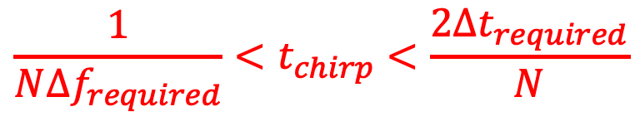


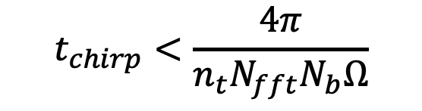
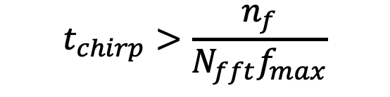

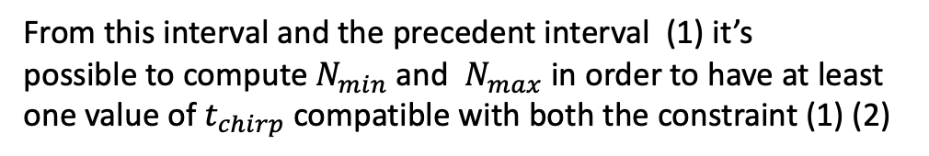
Extraction of constraint
Considering that compatible radar waveform must satisfy these conditions:
${Δt}_{computed}<{Δt}_{required}$ = 4 ms
It’s possible to obtain an interval of chirp duration values that satisfy these conditions
(this range depend on N)
${Δf}_{computed}<{Δf}_{required}$ = 1102 Hz
$$t_{chirp}>\frac{n_{f}}{N_{fft}f_{max}}$$
$$t_{chirp}<\frac{4π}{n_{t}N_{fft}N_{b}Ω}$$
$$∧$$
$${\frac{1}{N{Δf}_{required}}<t}_{chirp}<\frac{2{Δt}_{required}}{N}$$
From this interval and the precedent interval (1) it’s
possible to compute${ N}_{min}$ and ${ N}_{max}$ in order to have at least
one value of $t_{chirp}$ compatible with both the constraint (1) (2)
(2)

Slide 7
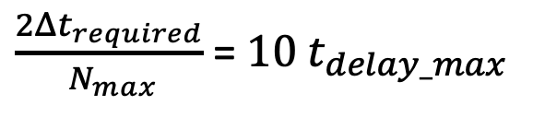
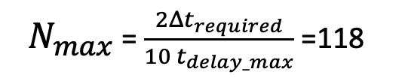

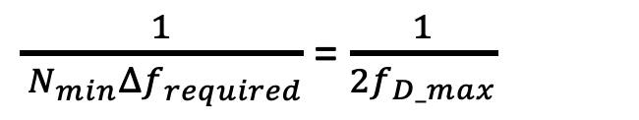
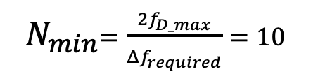
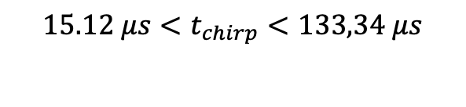

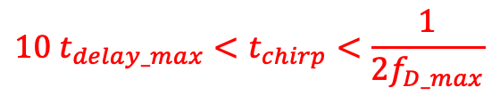

Extraction of constraint
Considering that compatible waveform must satisfy both these conditions:
$${10 t_{delay_max}<t}_{chirp}<\frac{1}{2f_{D_max}}$$
(1)
$${\frac{n_{f}}{N_{fft}f_{max}}<t}_{chirp}<\frac{2T_{BF}}{N_{fft}n_{t}}$$
(2)
$$66.7 μs$$
$$90. 744 μs$$
${ N}_{min}$ is obtained by imposing the lower bound of (2) equal to upper bound of (1)
There is also a constraint on
maximum choosen N related
to the number of ramps on
target M, in next slides
$\frac{1}{{ N}_{min}{Δf}_{required}}$ = $\frac{1}{2f_{D_max}}$
${ N}_{min}=\frac{2f_{D_max}}{{Δf}_{required}}=10$
${ N}_{max}$ is obtained by imposing the upper bound of (2) equal to lower bound of (1)
$\frac{2{Δt}_{required}}{{ N}_{max}}$ = $10 t_{delay_max}$
${ N}_{max}$ = $\frac{2{Δt}_{required}}{10 t_{delay_max}}$ =118
Choosing a middle value –> N = 60
$${15.12 μs<t}_{chirp}<133,34 μs$$

Slide 8


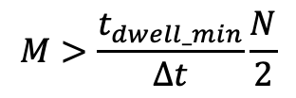
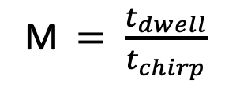






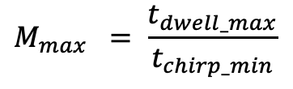
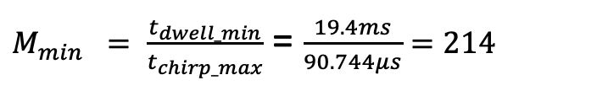

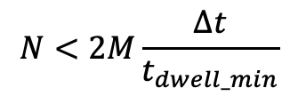
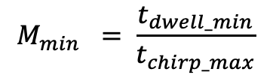


Extraction of constraint
Constraint on the number of ramps on target (M) during an observation time:
M$= \frac{t_{dwell}}{t_{chirp}}$
$$M_{min} = \frac{t_{dwell_min}}{t_{chirp_max}}$$
$$M_{max} = \frac{t_{dwell_max}}{t_{chirp_min}}$$
$t_{dwell}= \frac{θ_{az}}{6 rpm}$
$t_{scan}= \frac{60}{ rpm}$
$$M>\frac{t_{dwell_min}}{Δt}\frac{N}{2}$$
$$N<2M\frac{Δt}{t_{dwell_min}}$$
Min and max azimuth angle is related to the design of antenna
$θ_{az}≅$ 65 $\frac{λ}{d}$
$$θ_{az_min_}=7°$$
In order to have a not too small and not too big antenna
10 cm $<$d $<30 cm$
$$θ_{az_min_}=21°$$
Rpm is due to the maximum and minimum scan time, supposing that
$${rpm}_{min_}=12$$
$M_{min} = \frac{t_{dwell_min}}{t_{chirp_max}}$ = $\frac{19.4ms}{90.744μs}=214$
$$M_{max} =3539$$
1$s< t_{scan}$ $<5s$
$${rpm}_{max_}=60$$
$t_{dwell_min}$ for mD is 100 ms

Slide 9
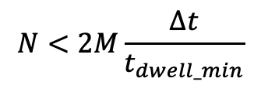
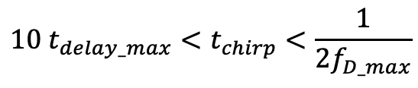
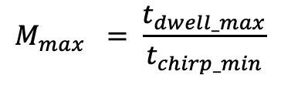
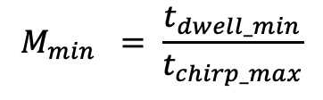

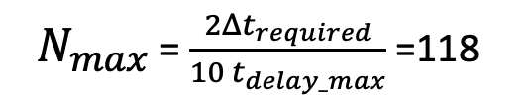
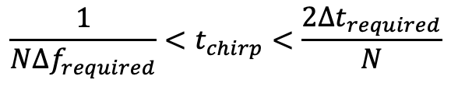
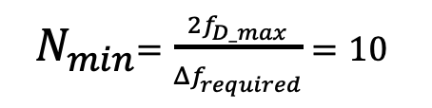
Recap
Limitations on chirp duration
$${10 t_{delay_max}<t}_{chirp}<\frac{1}{2f_{D_max}}$$
$$∧$$
$${\frac{1}{N{Δf}_{required}}<t}_{chirp}<\frac{2{Δt}_{required}}{N}$$
From mD resolution
From FMCW radar design
From mD effect
Limitations on length of STFT window: N
In order to have at least one value of chirp duration compatible
${ N}_{min}=\frac{2f_{D_max}}{{Δf}_{required}}=10$
${ N}_{max}$ = $\frac{2{Δt}_{required}}{10 t_{delay_max}}$ =118
Limitations on number of ramp on tgt: M
$$M_{min} = \frac{t_{dwell_min}}{t_{chirp_max}}$$
$$M_{max} = \frac{t_{dwell_max}}{t_{chirp_min}}$$
Further limitation on N
$$N<2M\frac{Δt}{t_{dwell_min}}$$

Slide 10
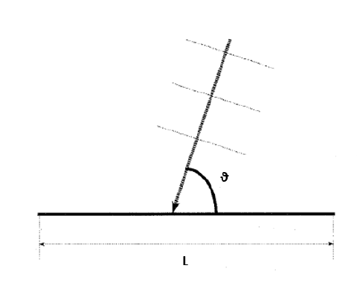
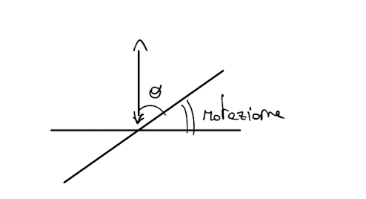




Signal model relation
If we consider the radar beam perpendicular to the blade, and the
Blade rotated, in order to obtain a relation between the aspect angle
And the rotation angle
$$Ωt$$
$$θ= \frac{π}{2} − Ωt$$
Turn it into cos and it is similar to chen exponential
(Chen)

Slide 11
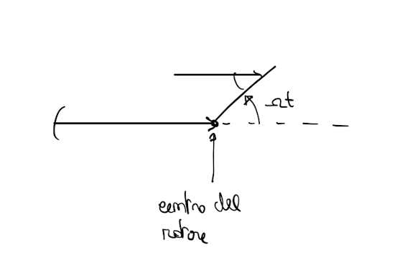

Signal model relation
In the Chen model the radar beam is consider parallel to the blade at
Time t = 0. After a time t the rotation of the blade make an aspect
Angle equal to the rotation
So the relation between the aspect angle and the rotation angle is
$$θ= Ωt$$
In the Chen model
That kind of relation depend on the initial position of the blade

